Slide 1
INTRODUCTION
Hi everyone, my name is Milind Pruthi. I am a final year student currently pursuing my BTech degree at S.R.M. Institute of Science and Technology(SRMIST).
This project is a part of my 6 month internship at NEC Corporation India.
The project focuses on building a Speaker Recognition System that will help in detecting interview frauds.

Slide 2
Technology Used
HTML, CSS and JavaScript have been used for the basic structure of the webpage.
Python and mySQL have been used for the backend programming.
IDE used – VSCode.
The program is run in Virtual Environment.
I am using voice recognition API provided by Azure.
Please read the documentation for setting up the system. Here is the documentation for understanding the API working and code segments.

Slide 3
Functionalities of the Web Page
Voice Enrollment Page.
Voice Verification Page.

Slide 4
Steps to use this Web Application
If the user is new to this, then the user has to first enroll their voice on the voice enrollment page.
For a user to enroll their voice, they have to provide their full name along with their email ID and their voice sample which will be recorded at run time.
Once the user is enrolled, the user can verify their voice on the voice verification page. The user has to enter their registered email ID and provide their voice sample for verification.

Slide 5
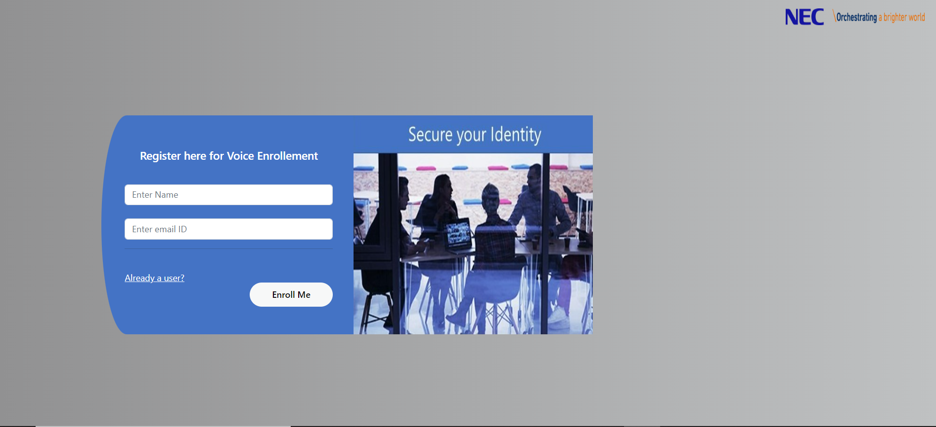
Voice Enrollment Page User Interface

Slide 6
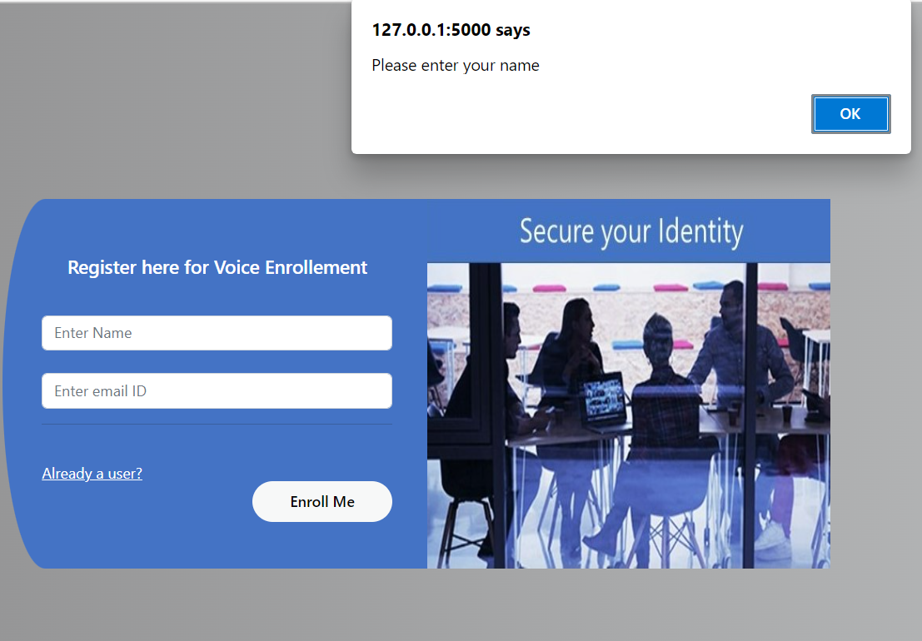
Voice Enrollment Page
Voice enrollment page has certain checks like certain entries can’t be left empty.

Slide 7
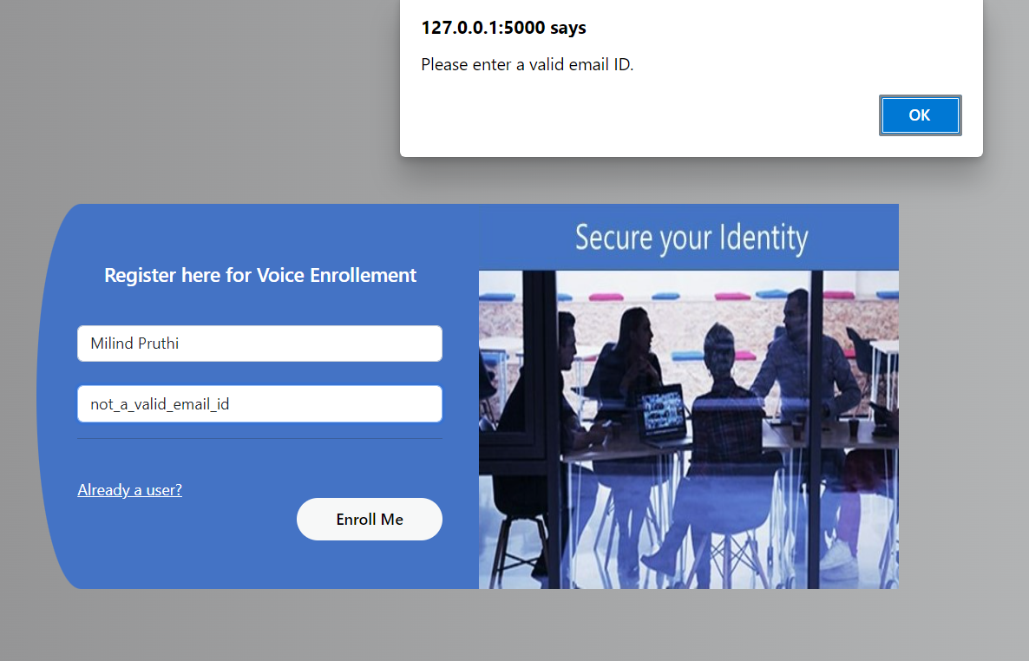
Voice Enrollment Page
Another check that is put into the voice enrollment page is that you have to enter a valid email ID.

Slide 8
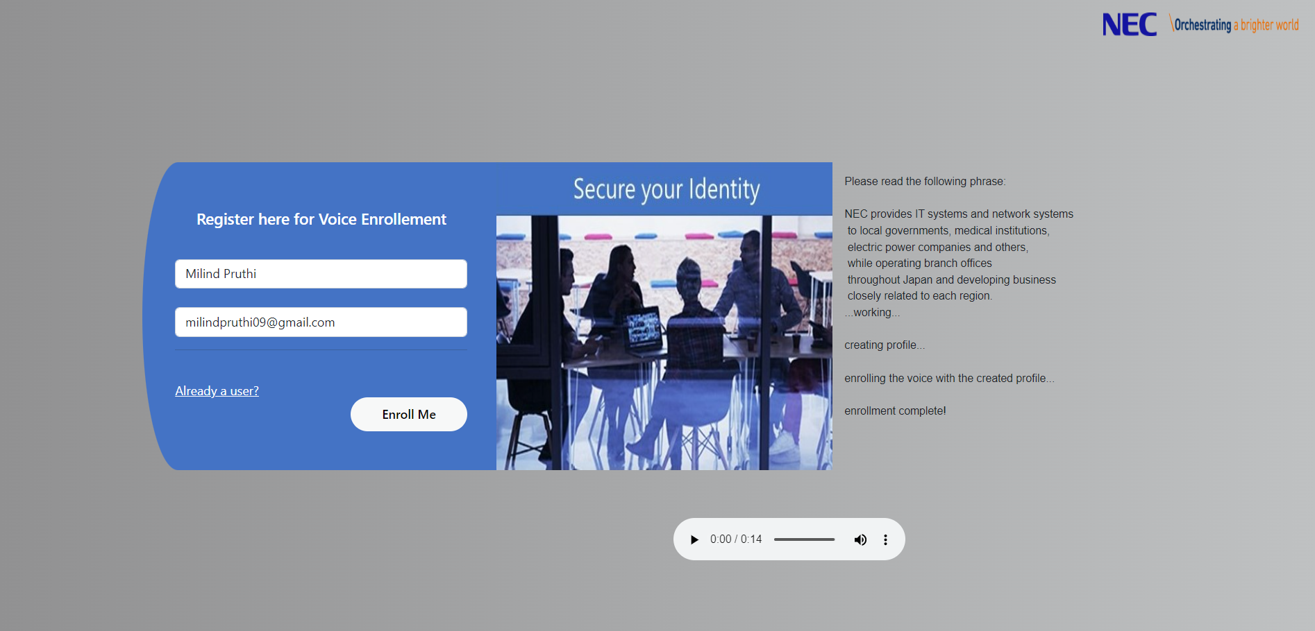
Voice Enrollment Process
Once you enter your name, a valid email ID and click on enroll me button, a phrase appears on the right side the page. Please read the phrase and your voice will get recorded. After some time you will see that the enrollment complete. This means the user is enrolled.

Slide 9
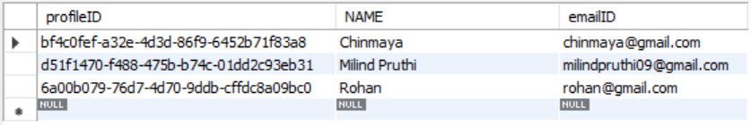
Database
Once the user gets enrolled, the user’s name and emailID are stored into the database and the user is assigned a unique profileID.

Slide 10
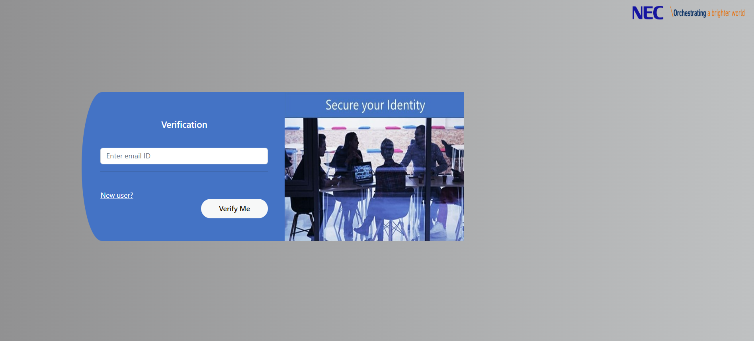
Voice Verification Page

Slide 11
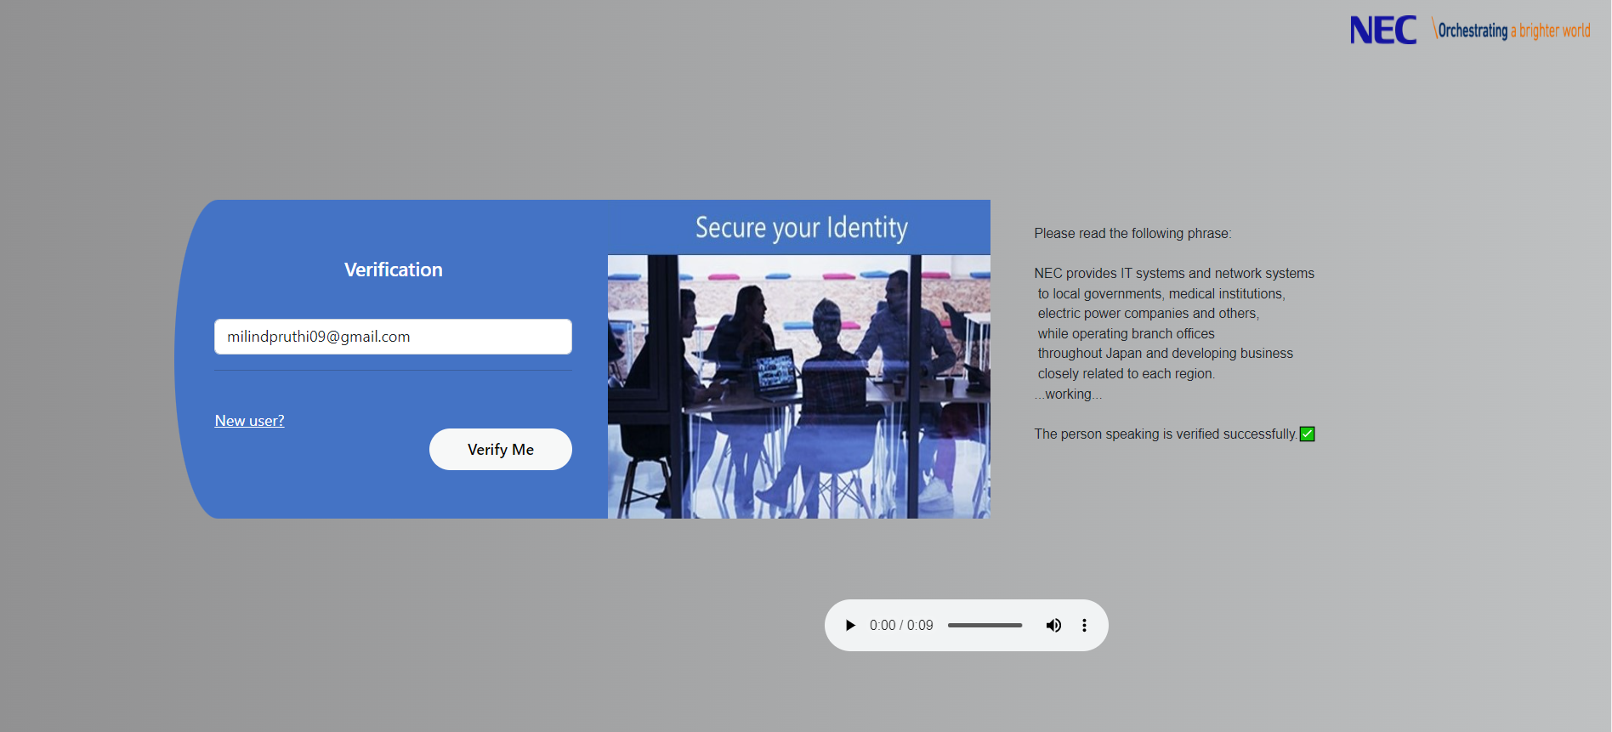
After entering the email ID on voice verification page, read the phrase on the screen and after a few seconds you will get a result on whether your voice matches or not.

Slide 12
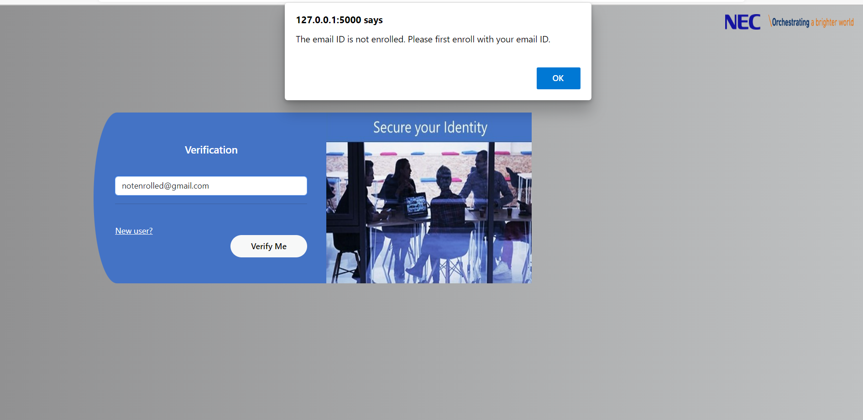
I have also added a few checks to check whether the email ID entered is valid i.e. its already enrolled or not. The below entered email ID is not enrolled so it gives a warning.

Slide 13
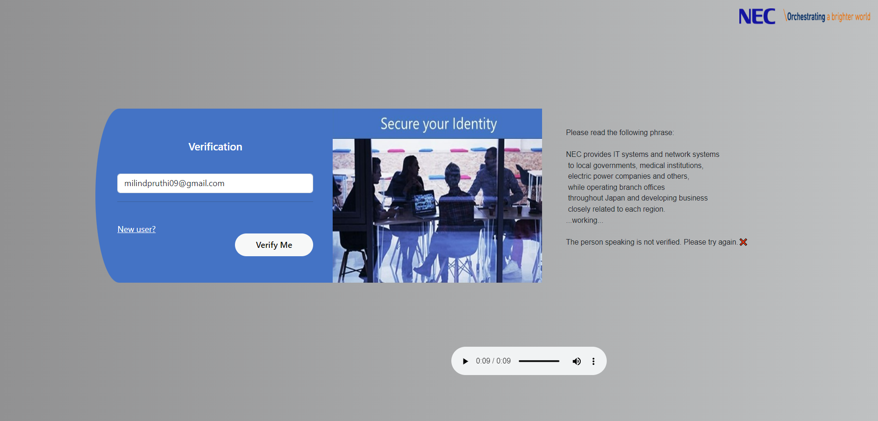
If a person other than the enrolled person tries to verify on the page it doesn’t verify.

Slide 14
Summary
This concluded the complete website including the front-end and back-end framework. I hope that my work could meet the expectations and I could present the desired output.
I would like to conclude this presentation by saying that it was really nice experience working here at NEC. I got to learn a lot about various things under the guidance of my mentor Ms. Shruti Shankar. I got to learn how it is to work under a professional environment, the importance of deadlines and how to work consistently.

Slide 15
THANK YOU
By – Milind Pruthi
Mentor – Ms. Shruti Shankar

